Slide 1
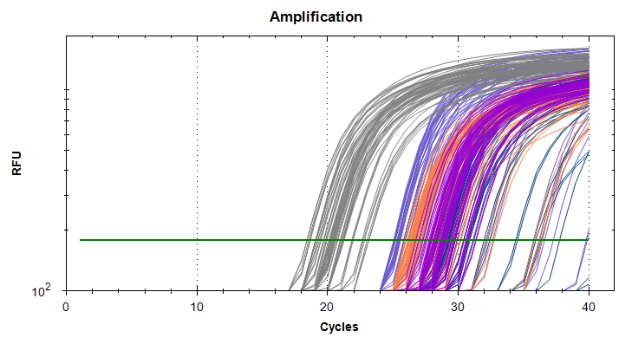
Quantitative Polymerase Chain Reaction (QPCR) Why, what and how?
Smadar Ben-Tabou de-Leon
Methods course, 4/7/2024

Slide 2


Why do we measure change in gene expression level in response to stress/habitat difference?
To decipher the genetic response to stress and environmental changes and understand the genetic defense mechanisms and their limitations
Stress
Sensors
Protection
Protein
TF
Mediators
mRNA
Death
Response gene
DNA
Nucleus
*Stress refers to heat, light, pollutant, hypoxia or any other environmental factor
Cell
TF- transcription factor

Slide 3
What do we measure? What do we need to extract from the cells?
What is our control?
Stress
Sensors
Protection
Protein
TF
Mediators
mRNA
Death
Response gene
DNA
Nucleus
Cell
TF- transcription factor

Slide 4
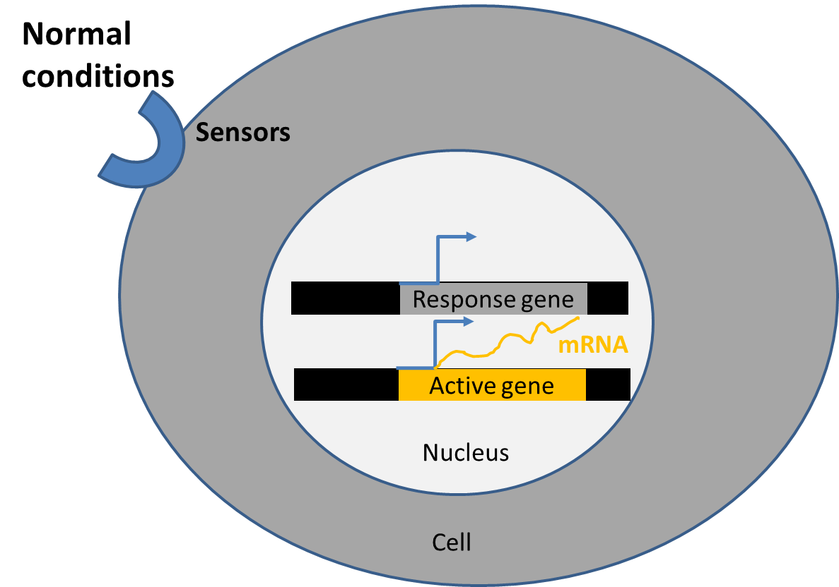
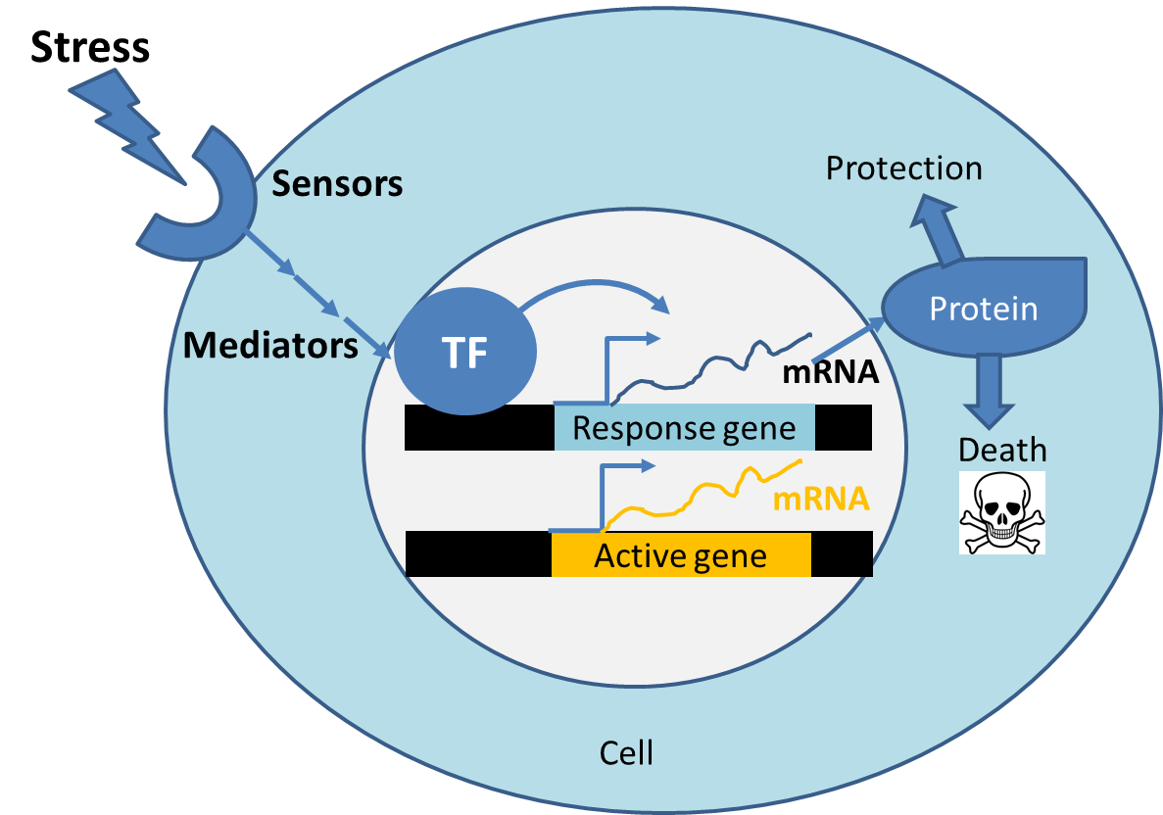
Our control is the same cell/organism grown in similar conditions except from the stress
Control
Treatment
We will try to identify the response genes - that are differentially expressed because of the stress

Slide 5
We will grow the control and treated samples, extract the RNA and generate cDNA from both
Control
Treatment
Why do we need cDNA?
RNA extraction
RNA
cDNA is more stable than RNA
We can do PCR and QPCR with DNA using DNA polymerase
RNA
Reverse transcription
cDNA
cDNA

Slide 6
Methods: measurement of gene expression level by QPCR – Why? What? How?
mRNA and cDNA preparation
PCR and QPCR Procedure
Controls:
Technical triplicates
DNA contamination
Non-specific amplification
Measurement of primer efficiency
Quantification of gene expression level compared to a reference gene
Absolute quantification (Developmental time course)
Relative quantification (treatment vs. control)
Plate design

Slide 7
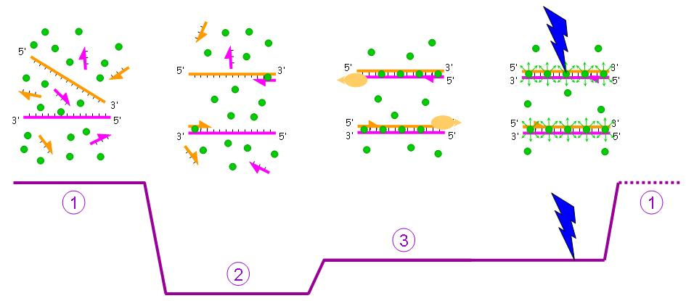
Amplifying specific DNA fragment by PCR
1 copy
Original DNA
2 copies
0
~94˚C
68-72˚C
50-60˚C
Ellongation
Denaturation
T
Annealing
1 cycle | 2 copies
2 cycles | 4 copies
3 cycles | 8 copies
N cycles | 2^{N} copies
Key caveats:
Too short elongation time – no amplification
Too high annealing temperature – no amplification
Too low annealing temperature – non-specific product

Slide 8
Amplifying specific DNA fragment by PCR
1 copy
Original DNA
2 copies
0
~94˚C
68-72˚C
50-60˚C
Ellongation
Denaturation
T
Annealing
Primer design:
Keep similar amplicon length for all primers (~150bp) that matches the extension time
Make sure that the annealing temperature matches your protocol
Use primer3: http://primer3.ut.ee/
If genome sequence is available you can design primers that are in different exons so they won’t be amplified from the DNA
Always test your primers in regular PCR to make sure that the size is correct and you don’t get non-specific bands
Make sure you put all the ingredients: Sample, Primers, Enzyme + nucleotides (sybr mix)

Slide 9
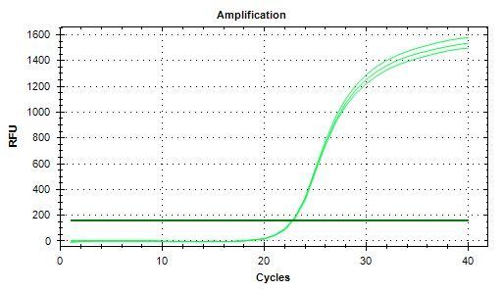
Using fluorescent nucleotides for quantification of gene expression by QPCR (Quantitative PCR)
Original cDNA
0
~94˚C
68-72˚C
50-60˚C
Extension
Denaturation
T
Annealing
Measurement
Typical fluorescence curve

Slide 10
Methods: measurement of gene expression level by QPCR – Why? What? How?
mRNA and cDNA preparation
PCR and QPCR Procedure
Controls:
Technical triplicates
DNA contamination
Non-specific amplification
Measurement of primer efficiency
Quantification of gene expression level compared to a reference gene
Absolute quantification (Developmental time course)
Relative quantification (treatment vs. control)
Plate design

Slide 11
The QPCR file reports the cycle number in which your sample crossed a threshold defined by the machine
Typical fluorescence curve
C₀
22.76
22.79
22.85
Fluorescence
Threshold

Slide 12
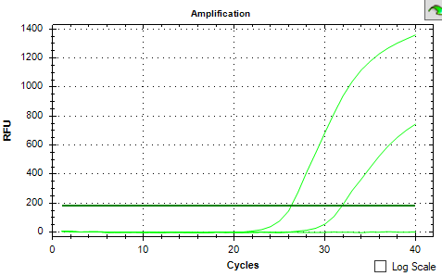
QPCR- internal controls
Technical triplicate – three wells with the same sample and primers
Variable cDNA concentrations
C₀
26.2
31.9
N/A
Bad!
∆C₀>1
Fluorescence
Typical fluorescence curve
C₀
22.76
22.79
22.85
Good!
∆C₀<0.5
Fluorescence
Threshold
Tsvia Gildor

Slide 13
QPCR- internal controls
Technical triplicate – three wells with the same sample and primers
Did the cDNA came from RNA or from DNA contamination?
RT-negative – RNA sample that didn’t go through RT-PCR so the only possible amplification is from DNA contamination – remember to leave some RNA for this control!
Typical fluorescence curve
C₀
22.76
22.79
22.85
Fluorescence
Threshold

Slide 14
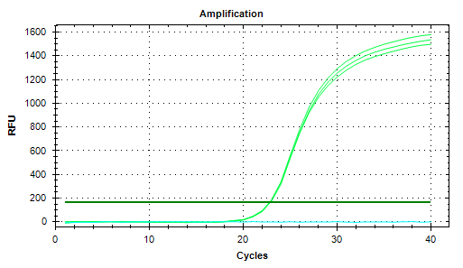
QPCR- internal controls
Technical triplicate – three wells with the same sample and primer
Run the primers with Negative-RT (RNA) and water
Did we amplify only the gene of interest or did we get non-specific amplification?
Even if the RT-negative sample pass the threshold at high Cycle number (>10 from the sample) you can use the data
C₀
22.76
22.79
22.85
N/A
Fluorescence

Slide 15
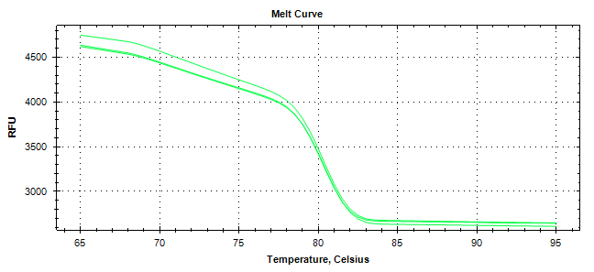
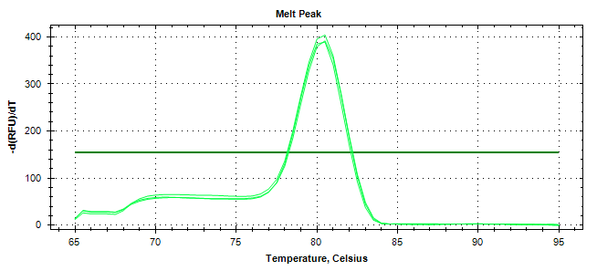
QPCR- internal controls
Technical triplicate – three wells with the same sample and primer
Run the primers with Negative-RT (RNA) and water
Melt and dissociation curves show if the amplification was specific
A major Peak at the amplicon annealing temperature
A major drop at the amplicon annealing temperature
Fluorescence
Derivative

Slide 16
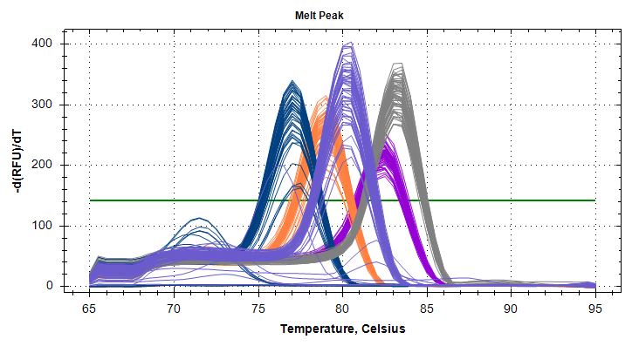
QPCR- internal controls
Technical triplicate – three wells with the same sample and primer
Run the primers with Negative-RT (RNA) and water
Melt and dissociation curves show if the amplification was specific
Derivative
Gene B
Gene A
Gene C
Gene E
Gene D

Slide 17
Methods: measurement of gene expression level by QPCR
mRNA and cDNA preparation
PCR and QPCR Procedure
Controls:
Technical triplicates
DNA contamination
Non-specific amplification
How efficient is the amplification? Measurement of primer efficiency
Quantification of gene expression level compared to a reference gene
Absolute quantification (Developmental time course)
Relative quantification (treatment vs. control)
Plate design

Slide 18

QPCR – primer efficiency measurement by dilution sequence
In other words: looking for the actual base of the exponent $2^{C_{0}}$
To measure the primer efficiency – how efficient is the amplification at each cycle, we prepare a dilution sequence: Decreasing concentrations of cDNA in known ratio.
Then we test the difference in the cycle number for the different concentrations
A sample passed the threshold at cycle number 22.8
What will be the threshold of a sample that is 4 time lower in concertation?
C₀
22.76
22.79
22.85

Slide 19
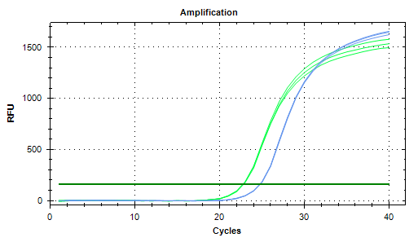

QPCR – primer efficiency measurement by dilution sequence
In other words: looking for the actual base of the exponent $2^{C_{0}}$
To measure the primer efficiency – how efficient is the amplification at each cycle, we prepare a dilution sequence: Decreasing concentrations of cDNA in known ratio.
Then we test the difference in the cycle number for the different concentrations
A sample passed the threshold at cycle number 22.8
What will be the threshold of a sample that is 4 time lower in concertation?
~24.8
C₀
C_{1:4}
22.76
22.79
22.85
24.83
24.76
24.74
1:4

Slide 20
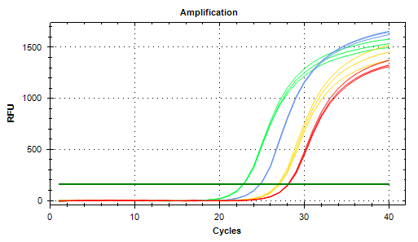

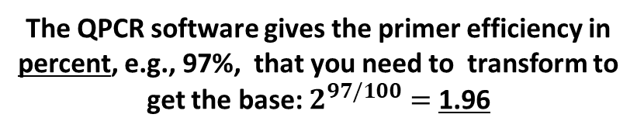
QPCR – primer efficiency measurement by dilution sequence
In other words: looking for the actual base of the exponent $2^{C_{0}}$
Cycle numbers measured in a dilution series:
C₀
C_{1:4} C_{1:16} C_{1:32}
The QPCR software gives the primer efficiency in percent, e.g., 97%, that you need to transform to get the base: $2^{97/100}=$ 1.96
22.76
22.79
22.85
24.83
24.76
24.74
27.06
27.10
26.88
28.13
28.16
28.07
~23 ~25 ~27 ~28
Gene name | %Efficiency | Exponent base
Alx | 96.954497 | 1.9582229
Blimp | 93.367963 | 1.9101417
bmp24 | 92.324455 | 1.8963754
Bra | 90.907191 | 1.8778371
Something the amplification behaves differently at low concentrations
In our lab we measured primer efficiencies in the range 1.8-2
Therefore we assume that in each cycle we get a amplification of ~1.9
1:4
1:4
1:16
1:32
Gildor and BDL Plos Gen 2015

Slide 21
Methods: measurement of gene expression level by QPCR
mRNA and cDNA preparation
QPCR Principles
Controls:
Technical triplicates
DNA contamination
Non-specific amplification
How efficient is the amplification? Measurement of primer efficiency
Quantification of gene expression level compared to a reference gene
Absolute quantification (Developmental time course)
Relative quantification (treatment vs. control)
Plate design

Slide 22
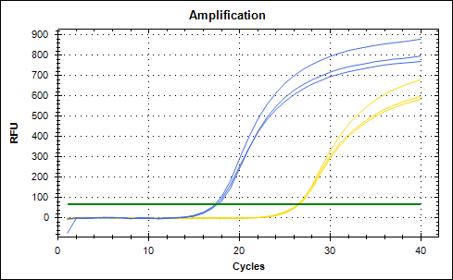

Absolut quantification of gene expression level
If the expression level of a reference gene is known, we can calculate the expression level of a gene of interest:
GeneofInterest
17.5
26.5
RefGene
RefGene =160000 mRNA/cell GeneofInterest =?
RefGene × 1.9^{17.5} = GeneofInterest × 1.9^{26.5}
$$\text{RefGene}×{1.9}^{(17.5−26.5)}=\text{GeneofInterest}$$
$$\text{GeneofInterest}=496 mRNA/cell$$
*RefGene could also be a “spike” – known amount of a given mRNA that we add to each well
Like GFP in Gildor and BTD Plos gen 2015

Slide 23
Example for developmental time course with a spike-in reference gene (GFP)
In developmental time course all the genes show high variation, and it is hard to find a good internal reference gene. Spike-in is use- add known number of cDNA and molecules of a foreign gene (GFP) and use it as a reference
Cycle #
Expression level
Cycle#
# cDNA
hpf
hpf
GFP= 650,000
Tbx2/3=650,000×1.9^{(CGFP-CTbx2/3)}
1bp=650g/mole
1bp=(650/6×10²³)×10⁹ng
1 copy = Length x (650/6×10²³)×10⁹ng
From Gildor and SBD, Plos Den 2015

Slide 24
At least 3 biological replicates are necessary for reliable measurement.
Cycle#
# cDNA
hpf
hpf

Slide 25
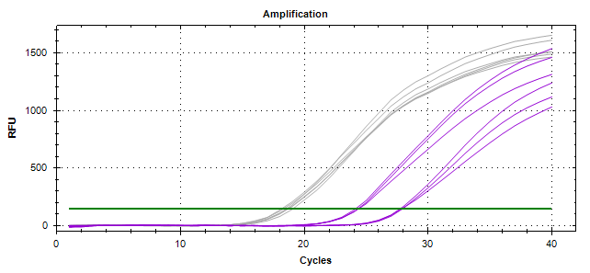

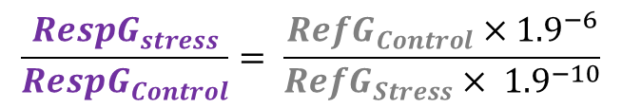



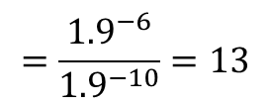
Relative quantification: control vs. treatment
The level of the reference gene did not change due to stress, what is the change in the level of a response gene?
RefGene Control
RefGene Stress
Response-gene
Stress
18
24
28
Response-gene
Control
Assuming:
${RefG}_{Control}$=${RefG}_{Stress}$
$${RespG}_{Control}={RefG}_{Control} ×{1.9}^{(18−28)}$$
$$={RefG}_{Control}× {1.9}^{−10}$$
$${RespG}_{Stress}={RefG}_{Stress} ×{1.9}^{(18−24)}$$
$$={RefG}_{Stress}× {1.9}^{−6}$$
$$\frac{{RespG}_{stress}}{{RespG}_{Control}}= \frac{{{RefG}_{Control}×1.9}^{−6}}{{RefG}_{Stress}× {1.9}^{−10}}$$
$$=\frac{{1.9}^{−6}}{{1.9}^{−10}}=13$$
ΔΔCt=(18-24)-(18-28)=4
ΔCt_stress
-ΔCt_control
Importantly: the level of the reference gene cancels out so you do not need to know the absolute level of your reference gene to get the change in your gene of interest!

Slide 26
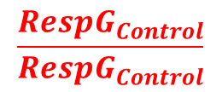
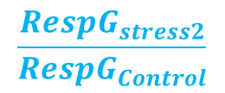
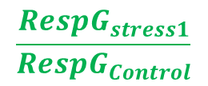
Example for measurement of the gene response to treatments using internal reference gene
When measuring the effect of a treatment (light, pH, T, etc.) on gene expression we need to use an internal reference gene that doesn’t change due to the treatment and will help us normalize variation due to mRNA extraction and RT-PCR efficiencies.
Ref-gene
Genes of interest
 | ubi | vegfR | vegf | pitx | myod | sm30 | rhogap
Control | 16.49 | 25.69 | 25.04 | 29.4 | 26.46 | 21.35 | 26.77
Stress 1 | 16.57 | 29.58 | 24.93 | 32.09 | 33.67 | 28.49 | 31.97
Stress 2 | 16.54 | 27.18 | 24.81 | 31.01 | 30.43 | 21.73 | 27.75
RT-neg | 28.42 | 36.46 | 36.67 | 36.25 | 31.32 | 34.04 | 31.29
Cycle# averaged over 3 technical replicates
3 biological replicates are necessary for reliable measurement.
$$\frac{{RespG}_{Control}}{{RespG}_{Control}}$$
$$\frac{{RespG}_{stress1}}{{RespG}_{Control}}$$
Error bars show STD over 3 biological replicates
Relative level
$$\frac{{RespG}_{stress2}}{{RespG}_{Control}}$$
Kristina Tarsis, 19.3.2020

Slide 27
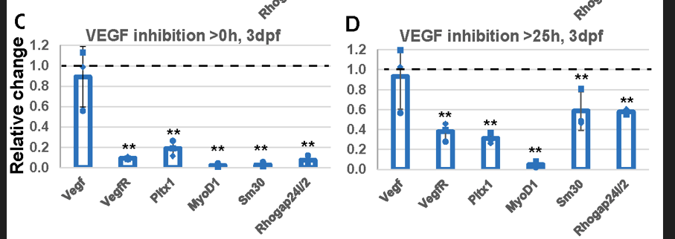
Example for journal presentation of QPCR results
Journals require to present the individual measurements together with the average and standard deviation (and the original excel file).
They request statistical tests for significance. We use the built-in z-test in excel.
** - p<0.001, one tailed z-test
Tarsis, Gildor, Morgulis, Ben-Tabou de-Leon, Dev Dyn 2022

Slide 28
Methods: measurement of gene expression level by QPCR
mRNA and cDNA preparation
QPCR Principles
Controls:
Technical triplicates
DNA contamination
Non-specific amplification
How efficient is the amplification? Measurement of primer efficiency
Calculating gene expression level compared to a reference gene
Absolute quantification (Developmental time course)
Relative quantification (treatment vs. control)
Plate design

Slide 29
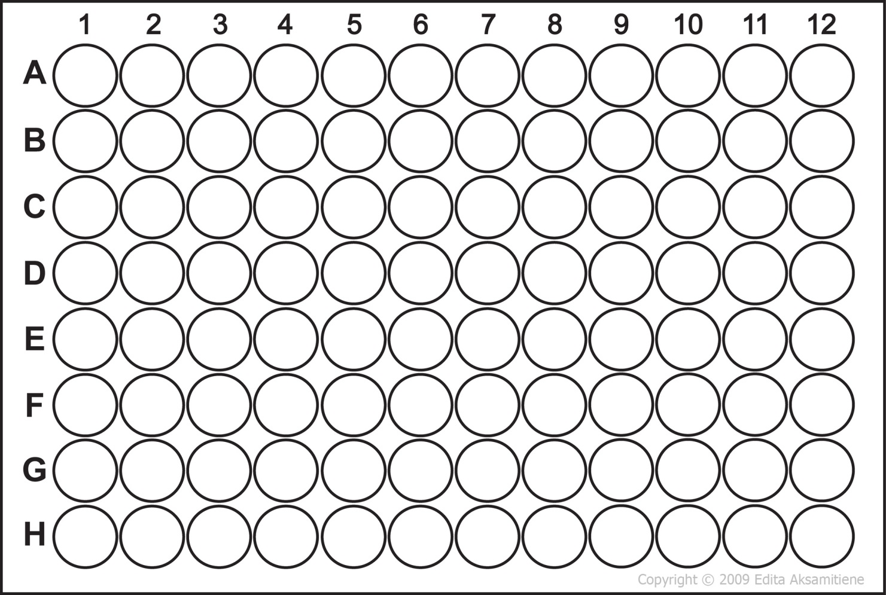
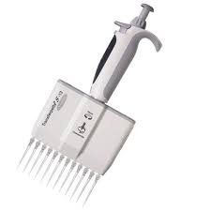
Plate design – all the samples and the primers of one biological replicate should be on the same plate
Different samples
]
]
]
18C
23C
28C
W
RT-neg
Different primers
Ref-A
Ref-B
HSP70
….
Multichannel pipettes are highly recommended
Take a look at the filled tips before you load into the plate to see that you filled evenly

Slide 30
Good luck!

